Slide 1
CS-468 Software Quality Assurance & Testing
Week 10
Session 2

Slide 2

Statement Coverage and Test Coverage –Loops Example
WHILE LOOP
X=15
COUNT=0
WHILE X<20
COUNT=COUNT+1
X=X+1
END WHILE
DO WHILE LOOP
X=15
COUNT=0
DO
COUNT=COUNT+1
X=X+1
WHILE X<20
END WHILE
FOR LOOP
COUNT=0
FOR X=15 TO 20
COUNT=COUNT+1
X=X+1
END FOR

Slide 3
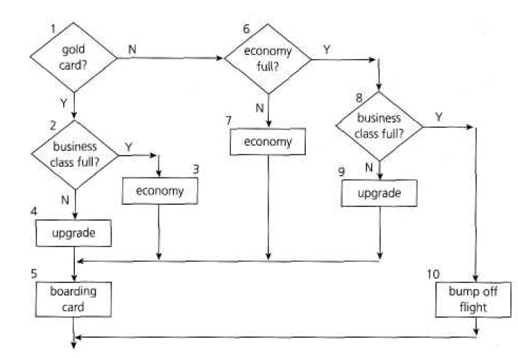
Statement Coverage and Test Coverage - Case Study
If you are flying with an economy ticket, there is a possibility that you may get upgraded to business class, especially if you hold a gold card in the airline's frequent flier program. If you don't hold a gold card, there is a possibility that you will get 'bumped' off the flight if it is full and you check in late? This is shown in following flow chart. Note that each box (i.e. statement) has been numbered.
GENERATE TEST DATA FOR MAXIMUM DECISION COVERAGE

Slide 4
Statement Coverage and Test Coverage - Case Study
Generate test data for maximum decision coverage.

Slide 5
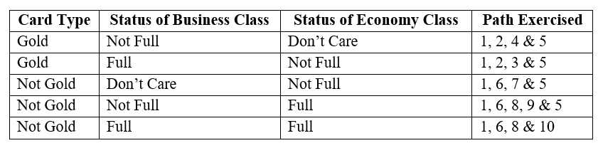
Statement Coverage and Test Coverage - Case Study
Test data for maximum decision coverage is as follows:

Slide 6
Statement Coverage and Test Coverage - Case Study
Following three tests have been executed, what is the statement coverage of these three tests?
Test 1: Gold card holder who gets upgraded to business class
Test 2: Non-gold card holder who stays in economy
Test 3: A person who is bumped from the flight

Slide 7
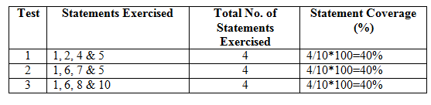
Statement Coverage and Test Coverage - Case Study
Answer:
Statement Coverage = Total No. of statements exercised/Total No. of statements *100
Total No. of statements = 10

